Slide 1
K8S Security Best Practise vxlan agent
LiuGang 2024-12-03

Slide 2







架构拓扑
App VPC
NLB
Cfos部署以Pod方式部署在容器内部
Cfos通过loadbalancer方式集成外部
NLB实现流量转发通信
CFos
ECR
CFos
Node-1
Node-2
app
sec

Slide 3
流量逻辑拓扑
App VPC
EKS Cluster
vxlan
Agent自动检测Pod 环境通过识别label方式，然后创建一个vxlan tunnel，这个tunnel从protected pod的vxlan0接口到cfos的vxlan0结束。然后agent再在protected pod里配置route将指定流量送的vxlan tunnel里面
agent
app-1
CFos
agent
…
…
app-N
Cfos N
Node-1
Node-2
app
sec
ECR
Notes:
hpa/keda –(rules)- Metric-server –cfos

Slide 4
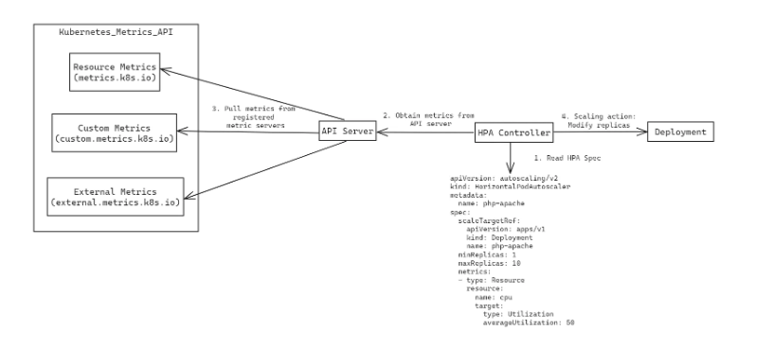
HPA 架构

Slide 5
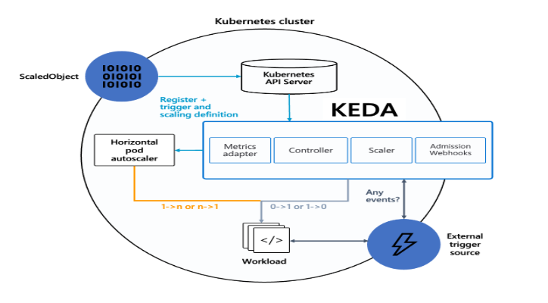
KEDA 架构

Slide 6
预先准备工作
预先准备AWS EKS环境
安装kubelet和eksctl
安装AWSLoadBalancerController
预先配置ECR私有镜像库，存储CFOS镜像
部署agent
License文件（当前FGT License文件即可）

Slide 7
安装EKS环境-1
#!/bin/bash -xe
AWS_REGION="us-east-1"
export AWS_PAGER=""
EKSVERSION="1.30"
CLUSTERNAME="democluster"
PODCIDR="10.244.0.0/16"
AVAILABILITY_ZONES=$(aws ec2 describe-availability-zones --region $AWS_REGION --query "AvailabilityZones[?State=='available'].ZoneName" --output text | tr '\t' ',' | cut -d',' -f1-2)
filename=“lgcluster.yaml"
cat << EOF | tee > $filename
apiVersion: eksctl.io/v1alpha5
kind: ClusterConfig
availabilityZones: [$(echo $AVAILABILITY_ZONES | tr ',' '\n' | sed 's/^/"/' | sed 's/$/"/' | paste -sd ',' -)]
metadata:
version: "${EKSVERSION}"
name: $CLUSTERNAME
region: $AWS_REGION
tags:
owner: wandy
iam:
withOIDC: true
managedNodeGroups:
- name: ${CLUSTERNAME}-eks-ng-app
labels:
nodegroup-type: external
role: worker
app: "true"
instanceType: t2.large
desiredCapacity: 1
minSize: 0
maxSize: 3
tags:
nodegrouprole: ${CLUSTERNAME}
volumeSize: 100
iam:
withAddonPolicies:
externalDNS: true
certManager: true
awsLoadBalancerController: true
albIngress: true
ebs: false
efs: false
imageBuilder: false
cloudWatch: true
privateNetworking: true
preBootstrapCommands:
- "echo test"

Slide 8
安装EKS环境-2
ssh:
allow: true # will use ~/.ssh/id_rsa.pub as the default ssh key
enableSsm: true
- name: ${CLUSTERNAME}-eks-ng-security
labels:
nodegroup-type: external
role: worker
security: "true"
instanceType: t2.large
desiredCapacity: 1
minSize: 0
maxSize: 3
tags:
nodegrouprole: ${CLUSTERNAME}
volumeSize: 100
iam:
withAddonPolicies:
externalDNS: true
certManager: true
awsLoadBalancerController: true
albIngress: true
ebs: false
efs: false
imageBuilder: false
cloudWatch: true
ssh:
allow: true # will use ~/.ssh/id_rsa.pub as the default ssh key
enableSsm: true
kubernetesNetworkConfig:
ipFamily: IPv4
serviceIPv4CIDR: 10.96.0.0/16
vpc:
autoAllocateIPv6: false
cidr: ${PODCIDR}
clusterEndpoints:
privateAccess: true
publicAccess: true
nat:
gateway: HighlyAvailable # other options: Disable, Single (default) ,HighlyAvailable
accessConfig:
bootstrapClusterCreatorAdminPermissions: true # default is true
authenticationMode: API
EOF

Slide 9
安装EKS环境-3
eksctl get cluster --name $CLUSTERNAME --region $AWS_REGION || eksctl create cluster -f $filename
aws eks create-addon --addon-name eks-pod-identity-agent --cluster ${CLUSTERNAME} --addon-version v1.0.0-eksbuild.1 --region $AWS_REGION
kubectl get pods -n kube-system | grep 'eks-pod-identity-agent' || true
kubectl apply -f https://github.com/kubernetes-sigs/metrics-server/releases/latest/download/components.yaml
(components.yaml如果服务器无法访问，可以下载下来手工上传执行)
aws eks list-access-entries --cluster-name ${CLUSTERNAME} --region $AWS_REGION

Slide 10
验证集群环境

Slide 11

部署cfos 和 vxlan agent -1
docker run --rm -it \
-p 8080:8080 \
-e DEBUG=1 \
-e STORAGE=local \
-e STORAGE_LOCAL_ROOTDIR=/charts \
-v /opt/charts:/charts \
321536109689.dkr.ecr.cn-northwest-1.amazonaws.com.cn/lg-repository:chartmuseum
# curl localhost:8080/api/charts 校验服务
前置条件是需要将chartmuseum 镜像打包到本地私有ECR中部署私有化chart ， 然后将安装的helm包放到/opt/charts 目录中
Notes:
如何开机发现服务关闭 可以通过docker ps –a and docker start xxxxx

Slide 12

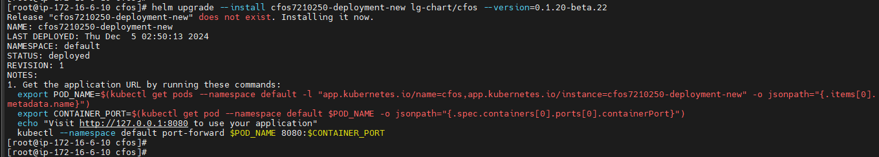
部署cfos 和 vxlan agent -2
helm repo add lg-chart http://localhost:8080/api/charts
helm repo update
helm search repo lg-chart --devel
helm upgrade --install cfos7210250-deployment-new lg-chart/cfos –version 0.1.20-beta.17
通过helm 安装打包好的cfos 和 agent yaml 以及相关参数配置效率更高， helm search --version 是因为当前版本还
处于beta ，未来release之后 ，就不用增加后缀
Notes:
Optional ： 指定详细参数安装
helm upgrade --install cfos7210250-deployment-new cfos-chart/cfos --set image.tag=cfosarm64v255 --set appArmor.enable --set deployment.kind=DaemonSet

Slide 13
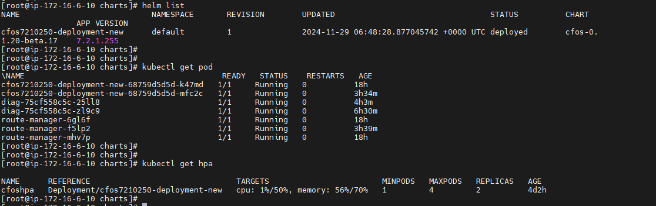
部署cfos 和 vxlan agent -3
校验安装，cfos 和 agent(route-manager)数量可以忽略，截图整个测试完成后进行的
Hpa 是 metrics-server k8s用于收集资源指标的服务，比如CPU、内存，后续用于cfos scal-out

Slide 14
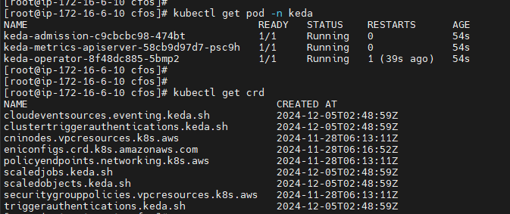
Optinal 部署keda
kubectl apply --server-side -f keda-2.13.1.yaml (https://github.com/kedacore/keda/releases/download/v2.13.1/keda-2.13.1.yaml)
Notes:
https://keda.sh/docs/2.16/deploy/#helm
#!/bin/bash kubectl delete ds route-manager name=$(helm list | grep cfos7210250-deployment-new | awk '{print $1}') echo $name helm uninstall $name

Slide 15
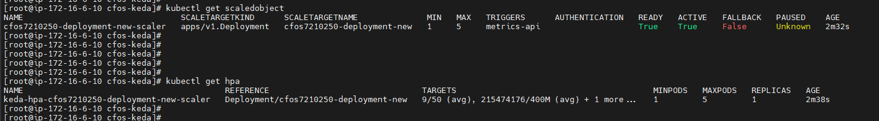
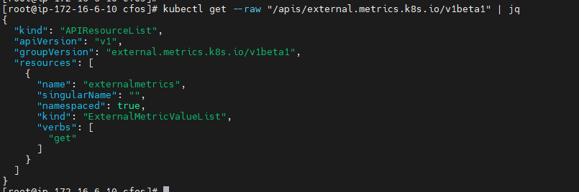
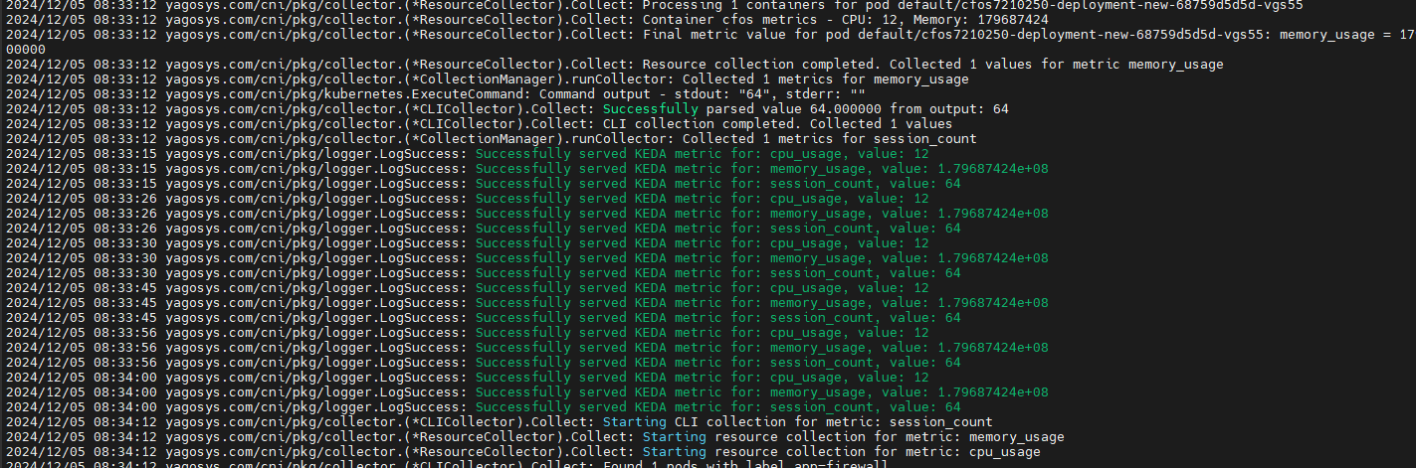
Optinal 验证keda
注意要先安装keda ,再安装agent/cfos
kubectl logs route-manager-45k7r（agent）

Slide 16
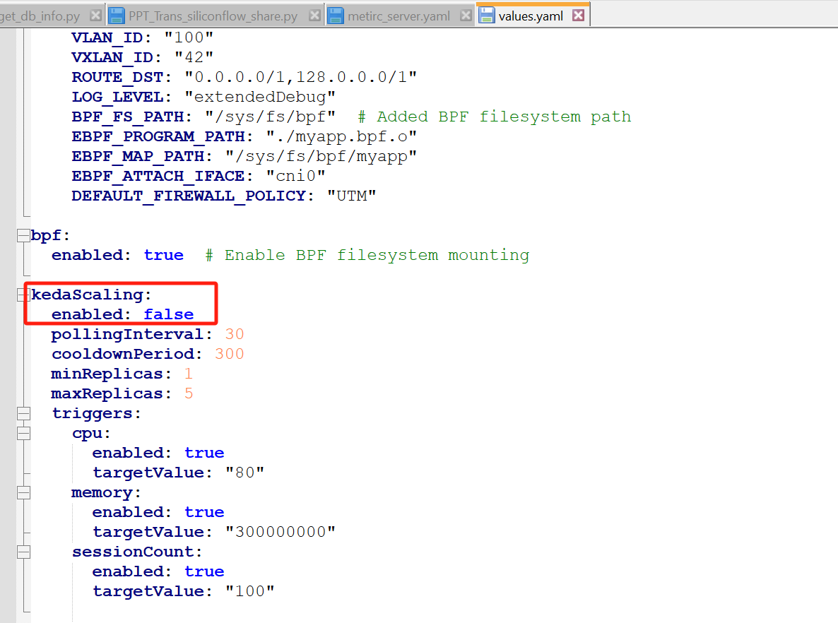
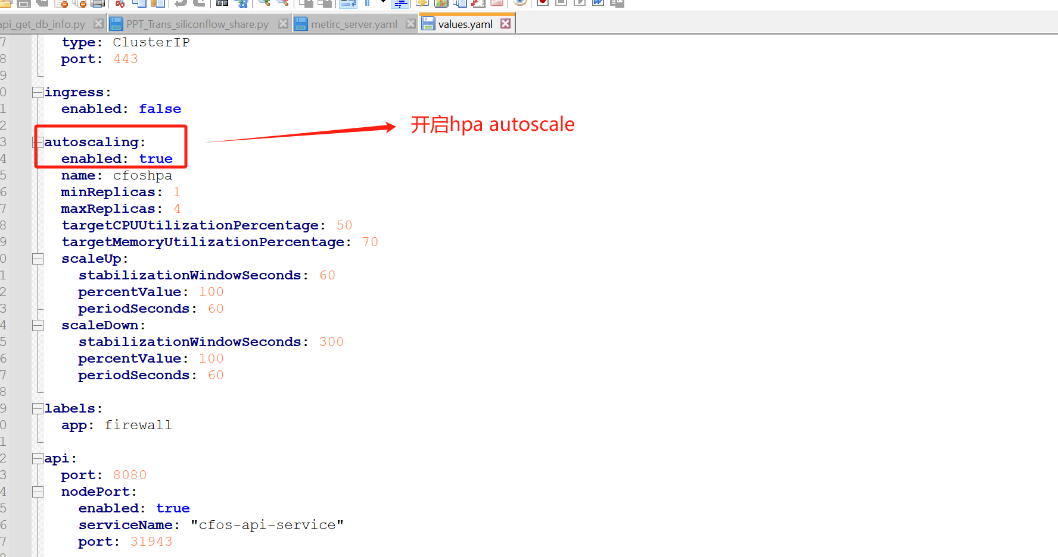
部署cfos 和 vxlan agent -4
Helm 通过charts来管理K8S应用，通过模板化部署资源，关于预定义参数修改如下
开启hpa autoscale 模式 ，需要开启hap ,关闭 keda,f如果开启keda autoscale，则相反，同时手工安装keda
helm install keda kedacore/keda --namespace keda --create-namespace
Notes:
helm install keda kedacore/keda --namespace keda --create-namespace

Slide 17
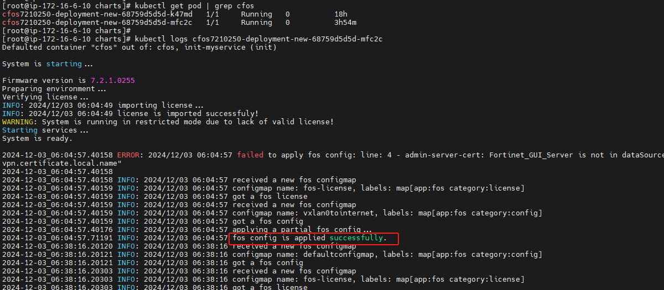
部署cfos license
kubectl apply -f cfos-license.yaml

Slide 18
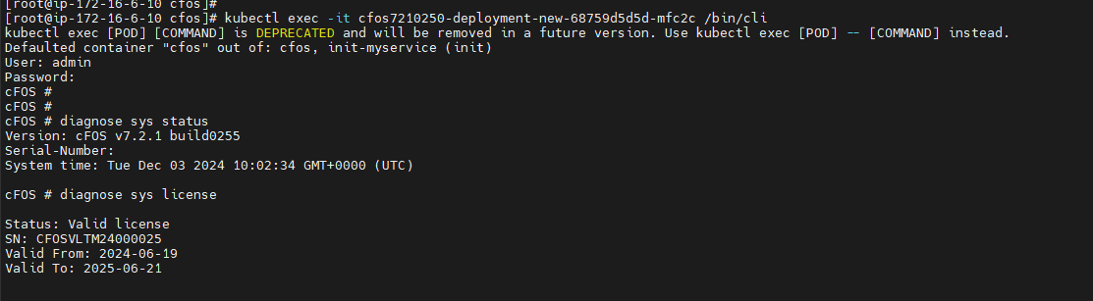
登录CFOS设备校验license
Notes:
用户名 admin 密码 空的

Slide 19
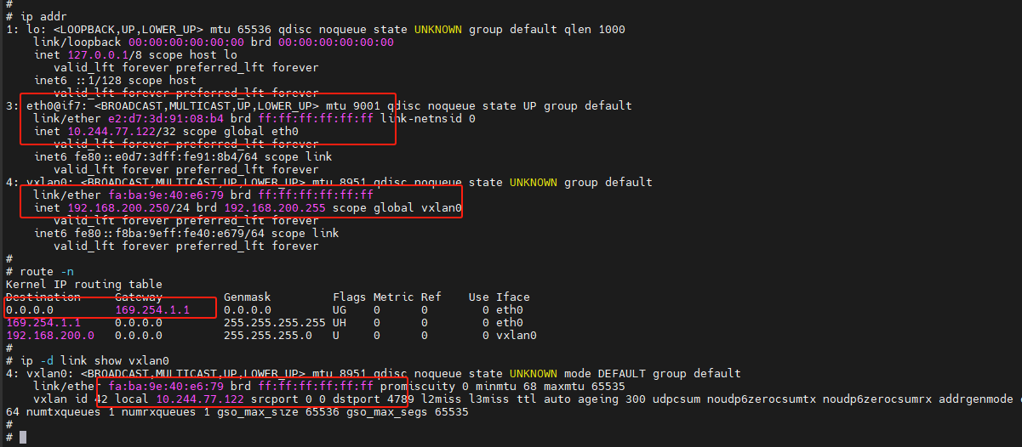
登录CFOS设备校验网络

Slide 20
部署cfos policy 和基础配置
config firewall ssl-ssh-profile
edit "mytest"
config https
set expired-server-cert allow
set revoked-server-cert allow
set cert-validation-failure allow
set sni-server-cert-check disable
set cert-probe-failure allow
end
set caname "Device"
set untrusted-caname "Device"
next
end
config firewall policy
edit 100
set utm-status enable
set name "vxlan0tointernet"
set srcintf "vxlan0"
set dstintf "eth0"
set srcaddr "all"
set dstaddr "all"
set service "ALL"
set ssl-ssh-profile "mytest"
set av-profile "default"
set ips-sensor "high_security"
set application-list "default"
set webfilter-profile "webfilter"
set nat enable
set logtraffic all
next
end
EOF
kubectl apply -f $filename
filename="net1tointernetfirewallpolicy.yaml"
cat << 'EOF' | tee > $filename
apiVersion: v1
kind: ConfigMap
metadata:
name: vxlan0tointernet
labels:
app: fos
category: config
data:
type: partial
config: |-
config webfilter content
edit 1
set name "webfilter"
config entries
edit "fortinet"
set pattern-type regexp
set status enable
set lang western
set score 10
set action block
next
end
next
end
config webfilter profile
edit "webfilter"
config web
set bword-threshold 10
set bword-table 1
end
config ftgd-wf
unset options
config filters
edit 1
set category 26
set action block
next
end
end
next
edit "default"
set log-all-url enable
set extended-log enable
next
end
config application list
edit "default"
set comment "Monitor all applications."
set extended-log enable
config entries
edit 1
set category 5
set action block
next
end
next
end

Slide 21
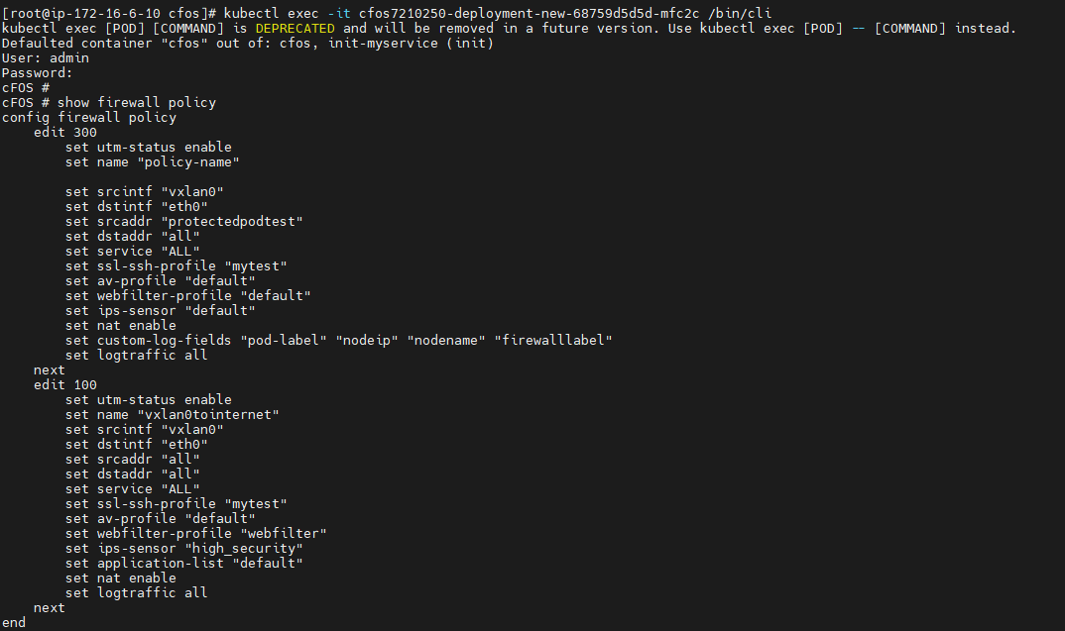
校验配置策略

Slide 22

部署测试应用
filename="protectedpod.yaml"
cat <<EOF | tee > $filename
apiVersion: apps/v1
kind: Deployment
metadata:
name: diag
labels:
app: diag
cfos: protected
spec:
replicas: 1
selector:
matchLabels:
app: diag
template:
metadata:
labels:
app: diag
protectedby: cfos
spec:
nodeSelector:
app: "true"
containers:
- name: diag
image: 321536109689.dkr.ecr.cn-northwest-1.amazonaws.com.cn/lg-repository:praqma
securityContext:
privileged: false
EOF
kubectl apply -f $filename

Slide 23
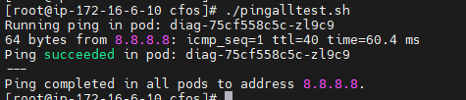
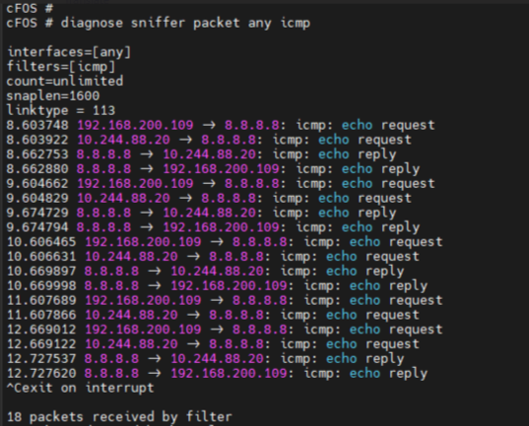
测试应用是否可以通过cfos访问Internet
filename="pingalltest.sh"
cat << 'EOF' | tee > $filename
#!/bin/bash
pods=$(kubectl get pods -l protectedby=cfos -o jsonpath='{.items[*].metadata.name}')
for pod in $pods; do
echo "Running ping in pod: $pod"
if kubectl exec $pod -- /bin/sh -c 'ping -c 1 -W 5 8.8.8.8 | grep ttl'; then
echo "Ping succeeded in pod: $pod"
else
echo "Ping failed in pod: $pod"
echo "Attempting manual ping for debugging:"
kubectl exec $pod -- ping -c 2 8.8.8.8
fi
echo "---"
done
echo "Ping completed in all pods to address 8.8.8.8."
EOF
chmod +x $filename
./$filename

Slide 24
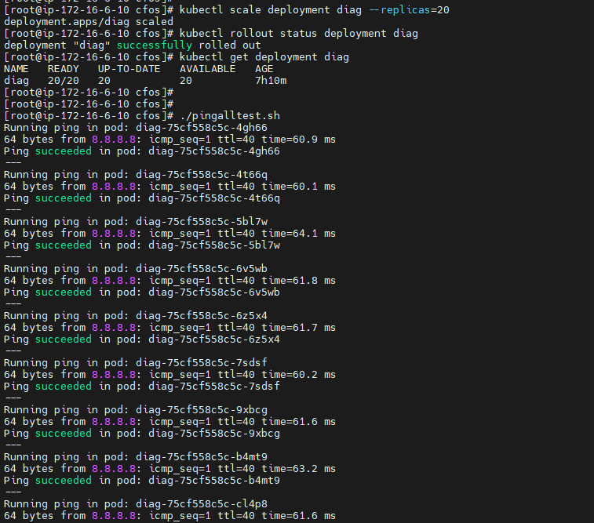
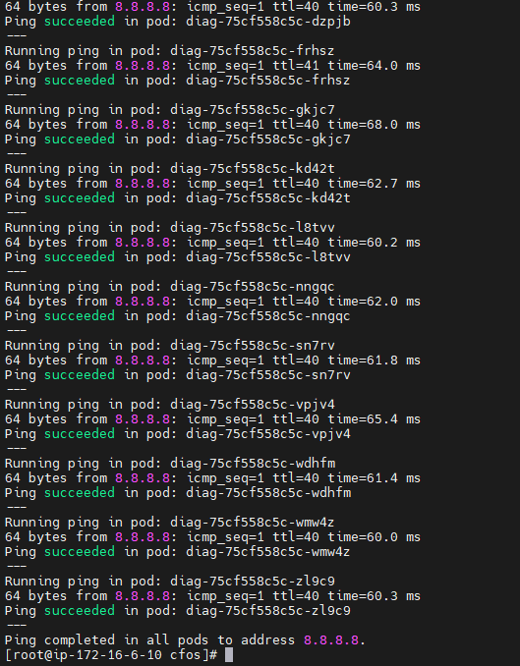
应用scale-out

Slide 25
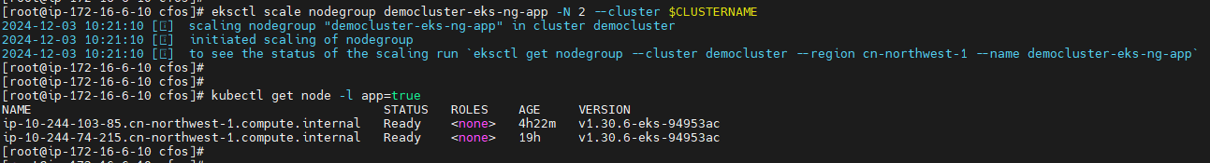
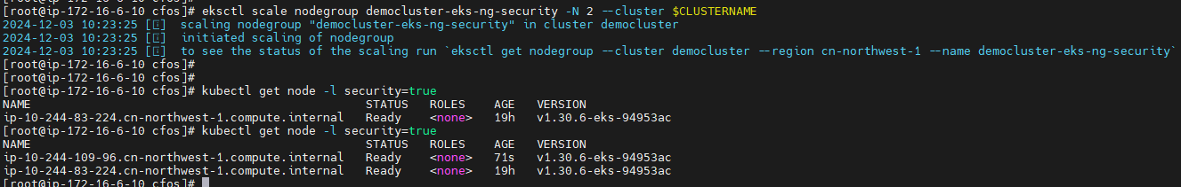
Node scale-out -1

Slide 26
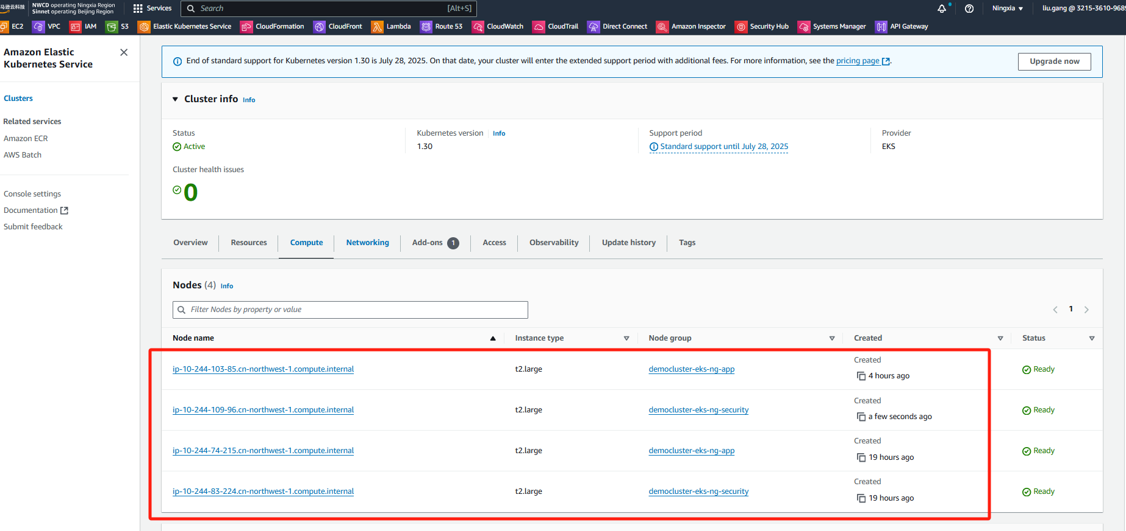
Node scale-out -2

Slide 27
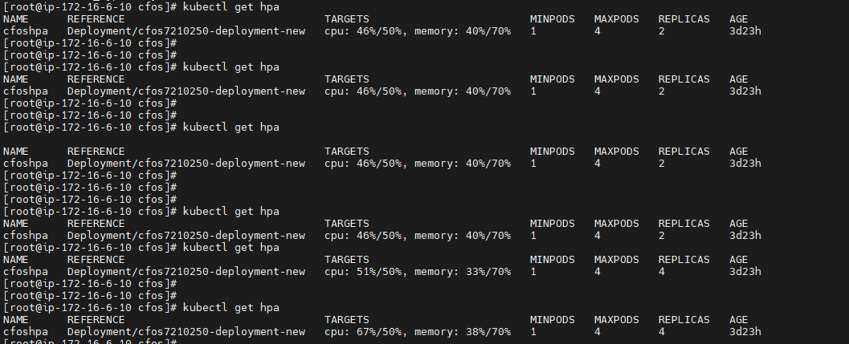
Cfos scale-out
通过命令执行增加node CPU利用，从而实现HPA横向自动扩容
(dd if=/dev/zero of=/tmp/bigfile bs=1G count=10 && sha512sum /tmp/bigfile) | tee /tmp/output.txt
pod=$(kubectl get pod -l app=firewall -o jsonpath='{.items[0].metadata.name}')
kubectl exec -it "$pod" -n "$NAMESPACE" -- sh -c 'while true; do /bin/busybox find / ; echo working...; done'

Slide 28
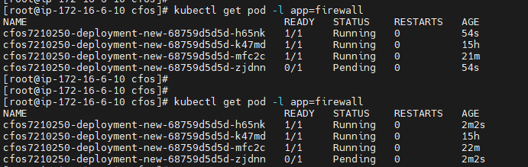
Cfos 通过 hpa 实现横向scale-out

Slide 29
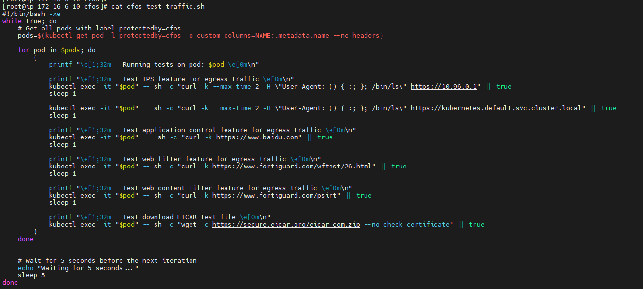
测试攻击流量

Slide 30
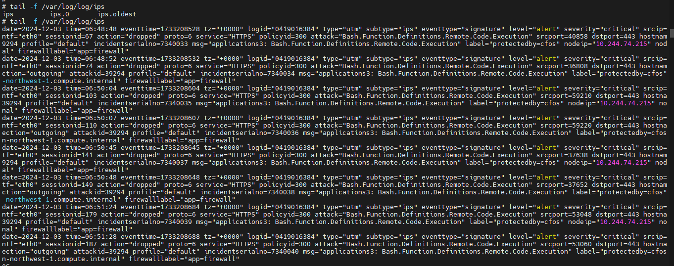
Cfos log -1

Slide 31
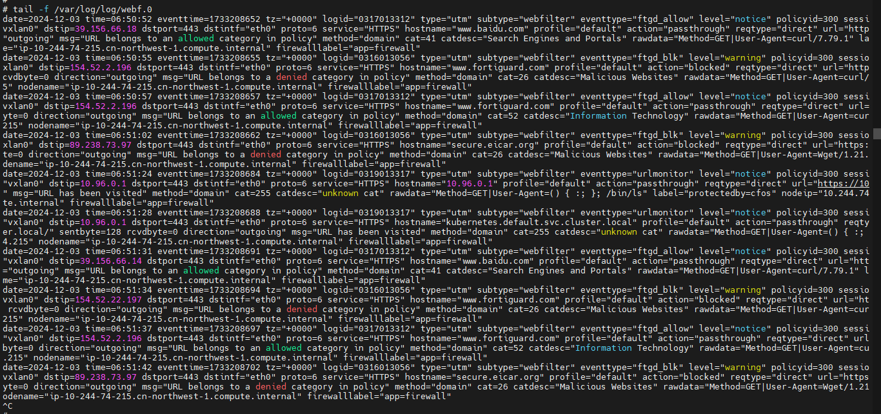
Cfos log -2

Slide 32
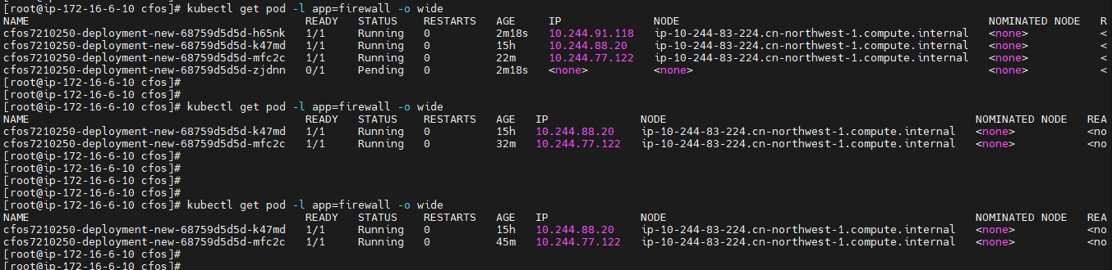
cfos hpa scale-in
当CPU资源利用率降下来之后，CFOS POD自动减少到部署数量

Slide 33
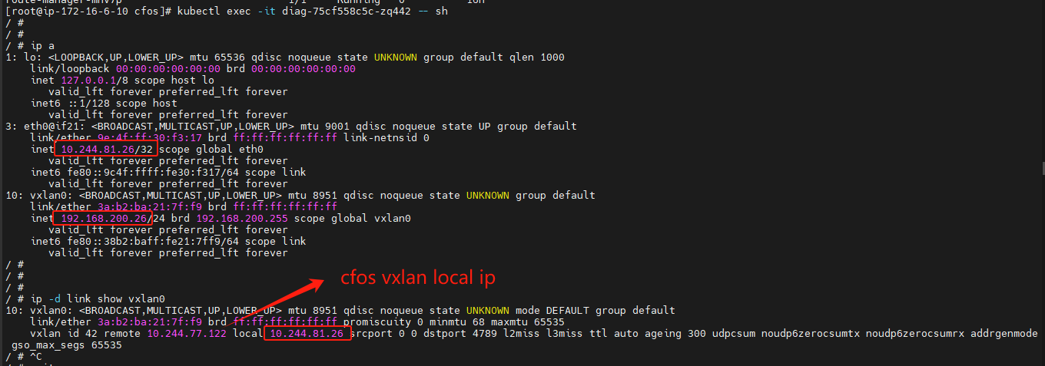
App-1 vxlan tunnel

Slide 34
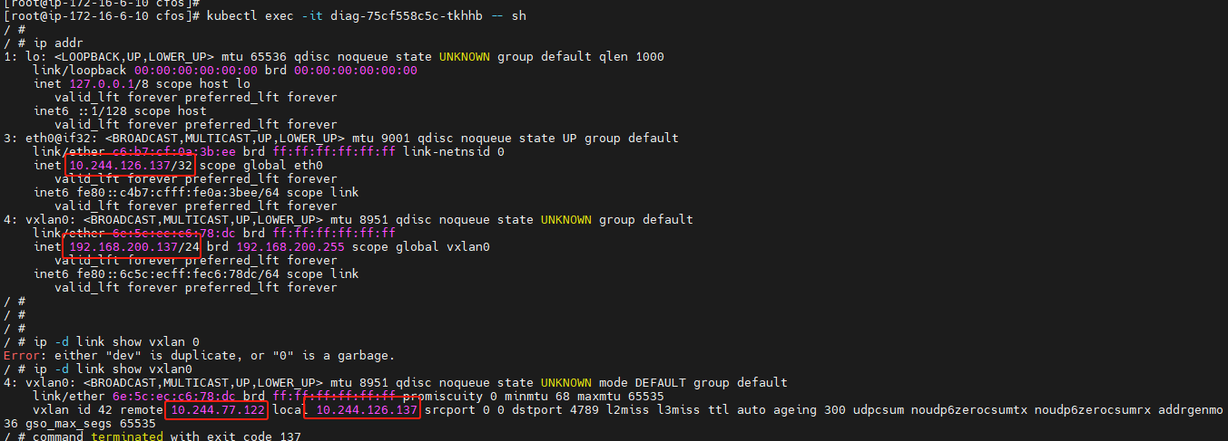
App-2 vxlan tunnel

Slide 35
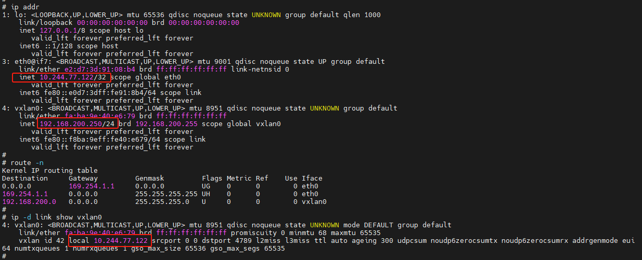
cfos vxlan tunnel

Slide 36
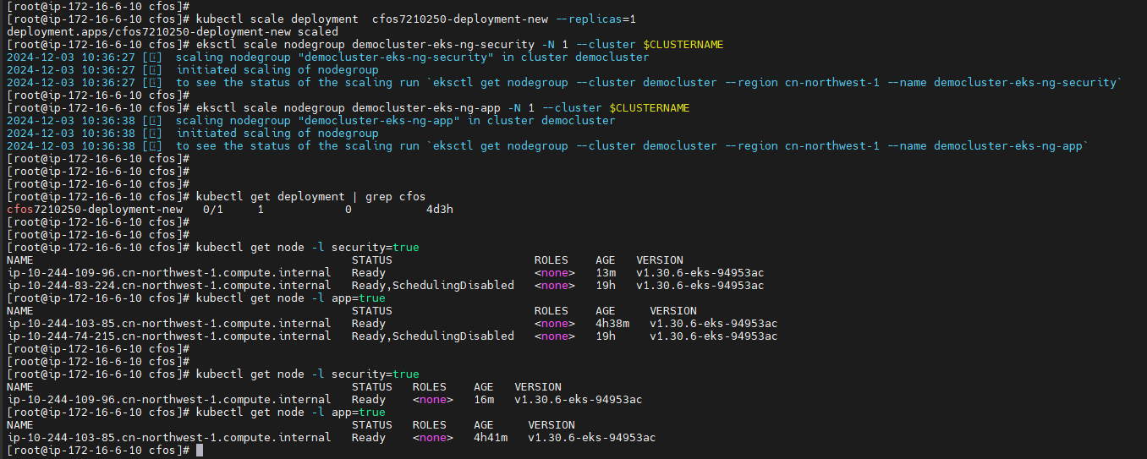
cfos node scale-in

Slide 37
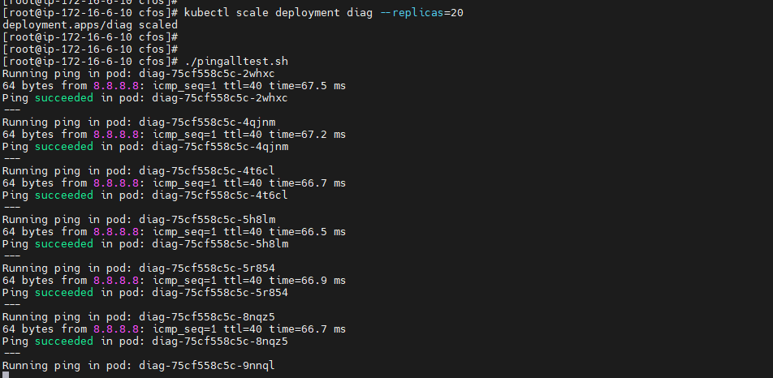
Cfos keda scale-out-1

Slide 38
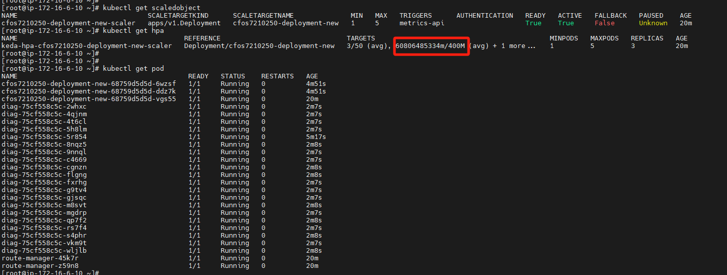
Cfos keda scale-out-2

Slide 39
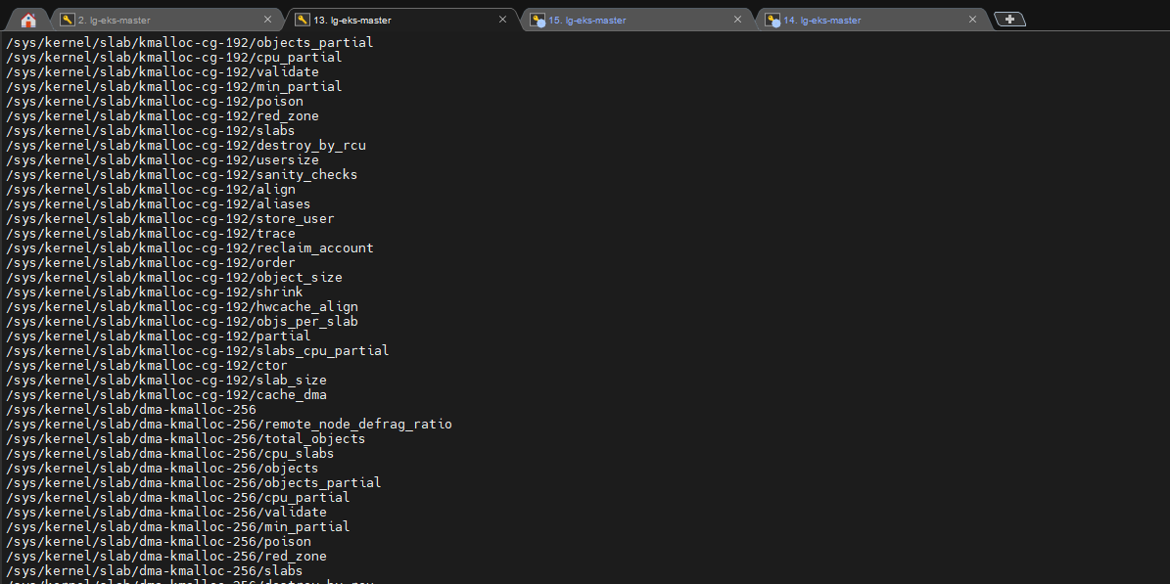
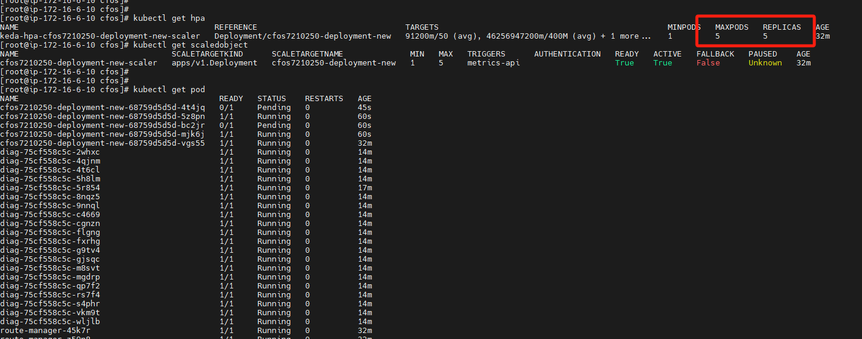
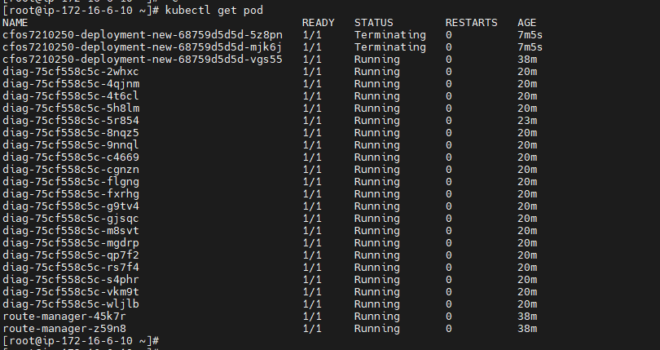
Cfos keda scale-out-3

